Slide 1

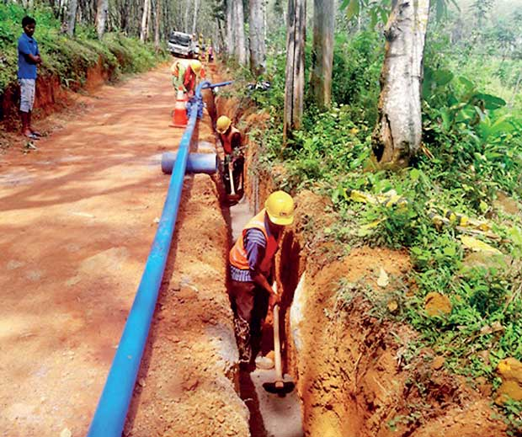
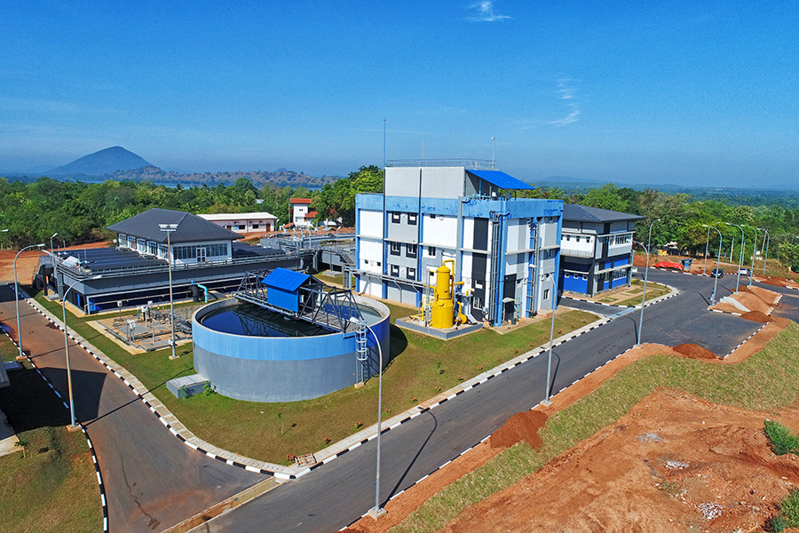



Replace This Text With Your Title
IWA Water Safety Conference & Exhibition 2026
Author/s
March 23-25, 2026, Ratmalana, Sri Lanka
Abstract
1. Introduction
3. Results
4. Conclusion
This is sample text for check the suitability and readability.
Figure 1. Sample Figure 1
2. Methodology
Start
Initial Tree
New point X_{i}
Update ancestor(s)
Cur_Node = ROOT
new_ROOT
(X_{i},Cur_Node)
dist
(X_{i},Cur_Node)
>θ
Cur_Node=ROOT
Figure 2. Sample Figure 2
5. References
Children =
get_children(Cur_Node)
Table 1. Sample Table 1
make_Sibling
(X_{i},Cur_Node)
 | Heading | Heading | Heading
Item
Item
Item
Item
Item
Item
Cur_Node=
min(dist(X_{i},Children))
Children={Φ}
No
Yes
Figure 1: Flow diagram of the proposed method
Chart 1. Sample Chart 1
Contact
Name :
Designation :
Email :
Phone :
7th International Conference for Water Safety
Center of Excellence for Water and Sanitation
National Water Supply and Drainage Board

